Slide 1
Instabook Inc
One stop platform for bibliophiles
Database Design Project
Anirudh Pillai
Madhuri Upadrasta

Slide 2
Who are we?
Local Bookstore based in Sacramento, California that recently moved its business to the cloud
Carefully curated collection from independent booksellers
If you don’t have a local bookstore or if you need a specific title (like a textbook) and are unable to find it anywhere, InstaBook is the right place to go!!

Slide 3
What does the database do?
- Allow customers to place orders
- View the orders
- Allow employee to access specific information at any time.

Slide 4
How does this database help?
- It will reduce the risk of errors that are susceptible while using a paper-based system.
- Improve efficiency by reducing time taken for processing information
-Allow the employees or staff members to quickly and easily generate the report of activities
-Eliminate paper work completely to keep track of orders
- Allow customers to place and view their orders

Slide 5
Our business rules
One customer can place many orders, One order can be placed by one customer only
One category can have many books, One book can have only one category
One book can have many orders, One order can have many books

Slide 6
How does this work?

Slide 7
What does these tables have?
Customer Information: related to customer (including items such as name, address and email ID, phone number, card type)
Book Information: related to books in store (including Author name, ISBN ,Price, Category, Edition, Publisher Stock quantity)
Order Information: related to order placed (including Order_id, Order_date and total price)
Employee Information: related to employee data (including Name, Employee id and Employee Email ID)
Category Information: related to different categories of books (including Category ID and Category Name)

Slide 8
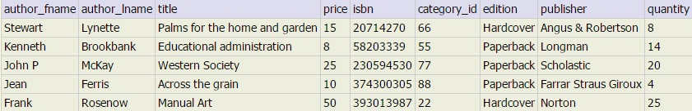
Table : book
PRIMARY AND FOREIGN KEYS
1.PRIMARY KEY:- ISBN
2.FOREIGN KEY:- category_id

Slide 9
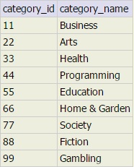
Table : category
PRIMARY KEY AND FOREIGN KEY
1.PRIMARY KEY:- Category_id
2.FOREIGN KEY:- NONE

Slide 10
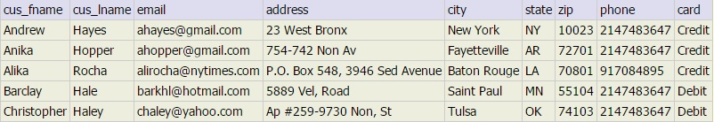
Table : customer
PRIMARY AND FOREIGN KEY
1.PRIMARY KEY:- Email
2.FOREIGN KEY:- None

Slide 11
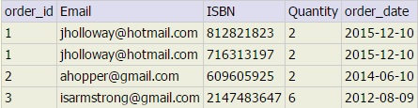
Table: orders
PRIMARY KEY AND FOREIGN KEY
1.PRIMARY KEY:- None
2.FOREIGN KEY:- Email, ISBN

Slide 12

Table : employee
NO PRIMARY KEY OR FOREIGN KEY
This table contains information about project members

Slide 13
Queries to perform

Slide 14
THANK YOU

